Slide 1
Income Effects on Poverty and Unemployment
By: Mitali Sathaye and Saqib Ali

Slide 2
Research in the Field
Household Poverty and Nonfatal Violent Victimization (Bureau of Justice Statistics): “Persons in poor households at or below the Federal Poverty Level had more than double the rate of violent victimization as persons in high-income households”

Slide 3
Our Question
Does income correlate with crime and unemployment statistics?

Slide 4
Data
US Census
From the years 2005 – 2010
State, County, Population, Income, Crime, Unemployment Rate
Source: https://www.census.gov/support/USACdataDownloads.html#POP

Slide 5
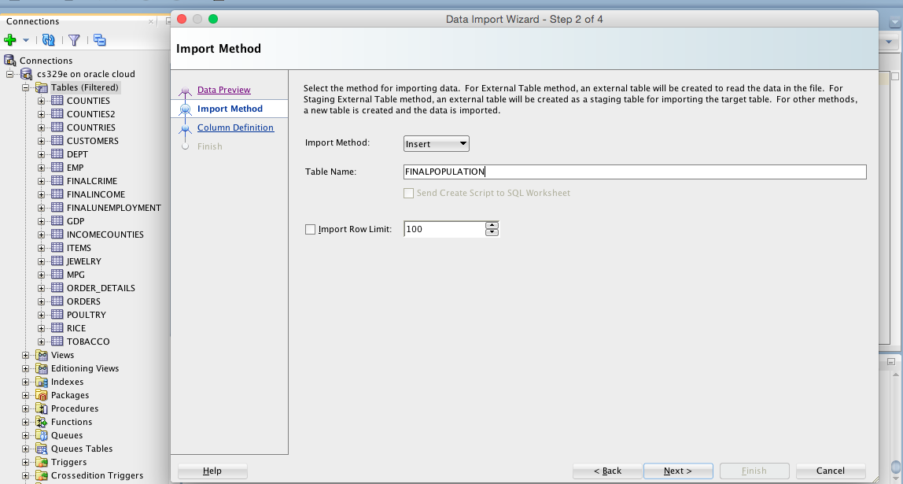
Upload Data to Oracle

Slide 6
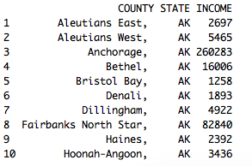
Import Data to R
INCOME <- data.frame(eval(parse(text=substring(getURL(URLencode('http://129.152.144.84:5001/rest/native/?query="select * from FINALINCOME"'), httpheader=c(DB='jdbc:oracle:thin:@129.152.144.84:1521:ORCL', USER='C##cs329e_mks2426', PASS='orcl_mks2426', MODE='native_mode', MODEL='model', returnFor = 'R', returnDimensions = 'False'), verbose = TRUE), 1, 2^31-1)))) %>% arrange(STATE)
(tbl_df(INCOME))

Slide 7
Compute Basic Statistics
averageincomebystate <- INCOME %>% group_by(STATE) %>% summarise(AvgIncome_State=mean(INCOME)) %>% arrange(desc(AvgIncome_State))
highestincomebycountyinstate <- INCOME %>% group_by(STATE) %>% summarise(HighestIncome=max(INCOME)) %>% arrange(desc(HighestIncome))
lowestincomebycountyinstate <- INCOME %>% group_by(STATE) %>% summarise(LowestIncome=min(INCOME)) %>% arrange(LowestIncome)

Slide 8
Melt Data into One Table
We wanted to graph income vs. crime, and to do that we needed to melt the data into one table
combineone <- full_join(averageincomebystate, averagecrimebystate, by = "STATE")
melttable <- melt(combineone, id=c("STATE"))

Slide 9
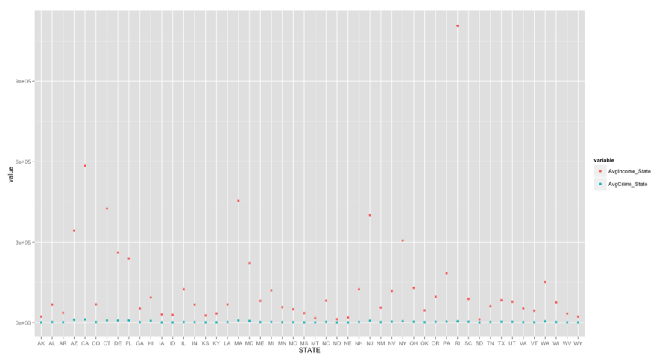
Rstudio ggplot
melttable %>% ggplot(aes(x=STATE, y= value, color=variable)) + geom_point()

Slide 10
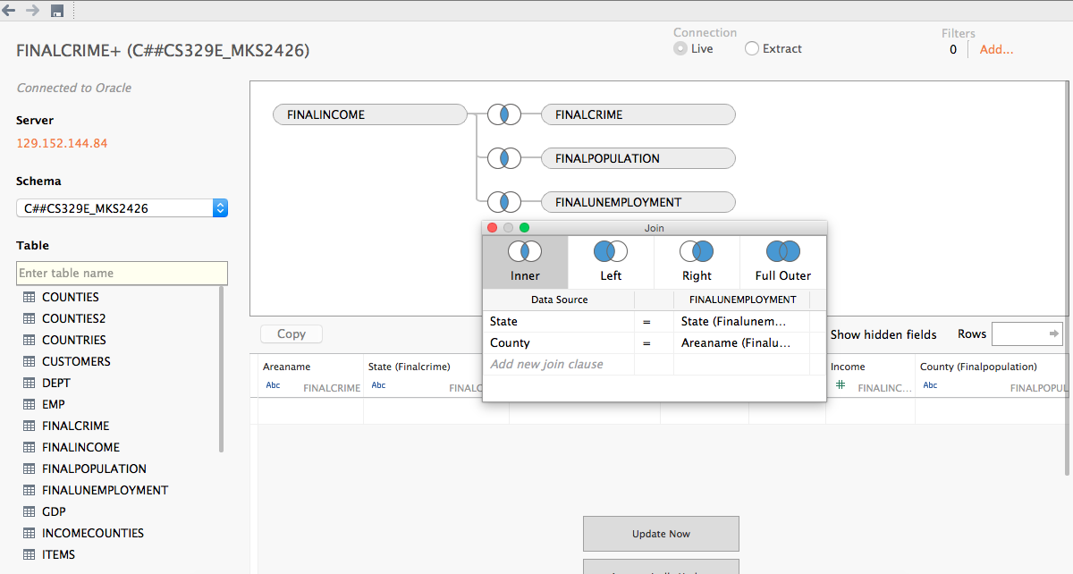
Import Data in Tableau

Slide 11
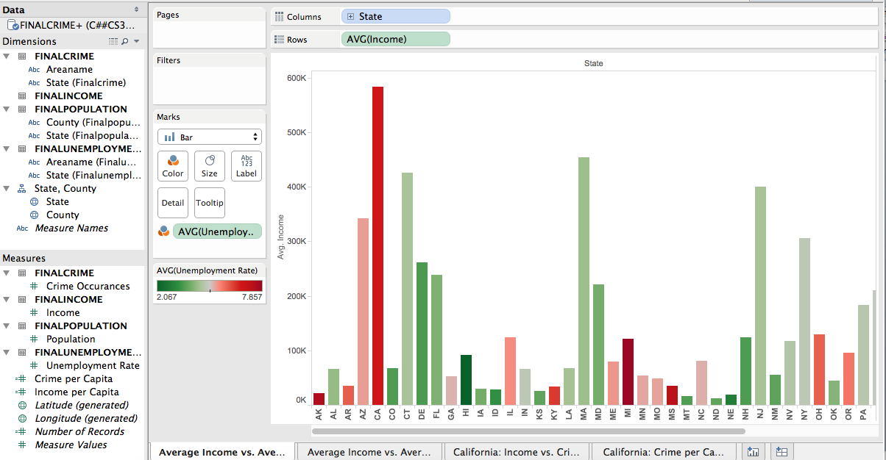
Sheet 1: Average Income vs. Average Unemployment

Slide 12
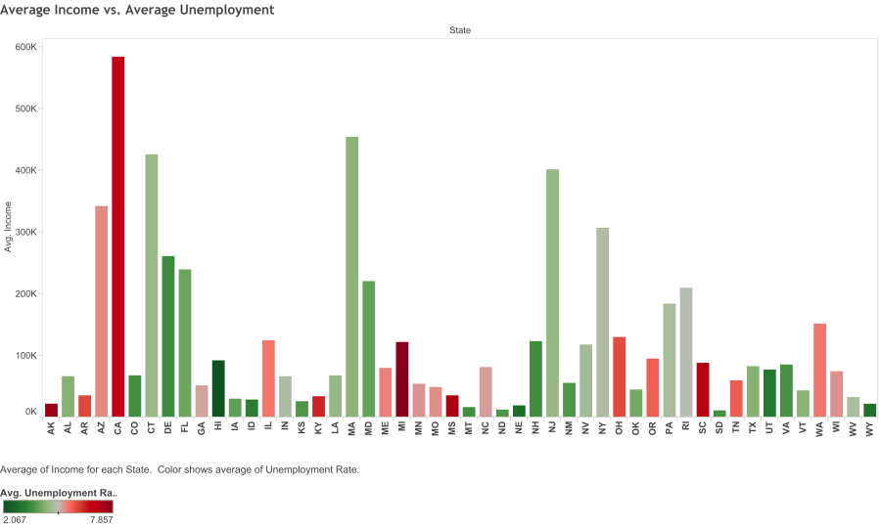
Sheet 1: Average Income vs. Average Unemployment

Slide 13
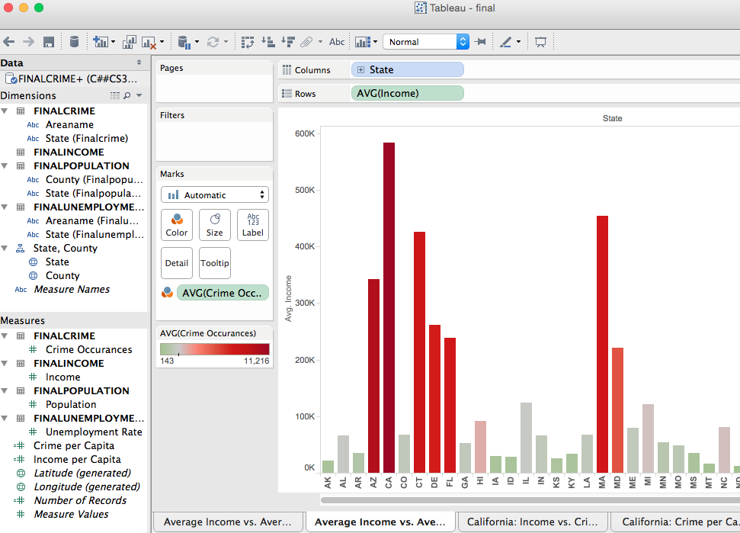
Sheet 2: Average Income vs. Average Crime

Slide 14
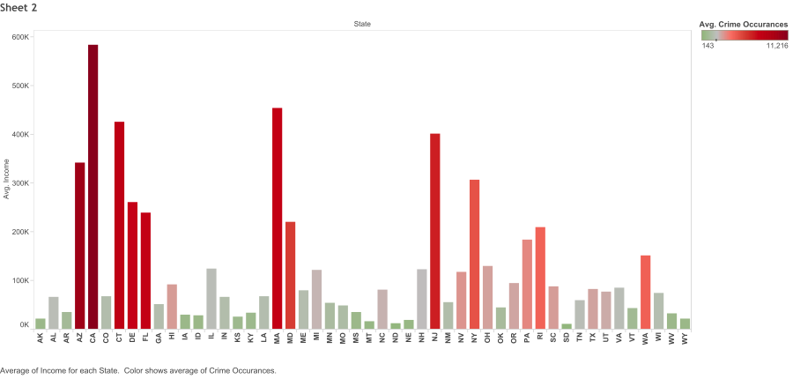
Sheet 2: Average Income vs. Average Crime

Slide 15
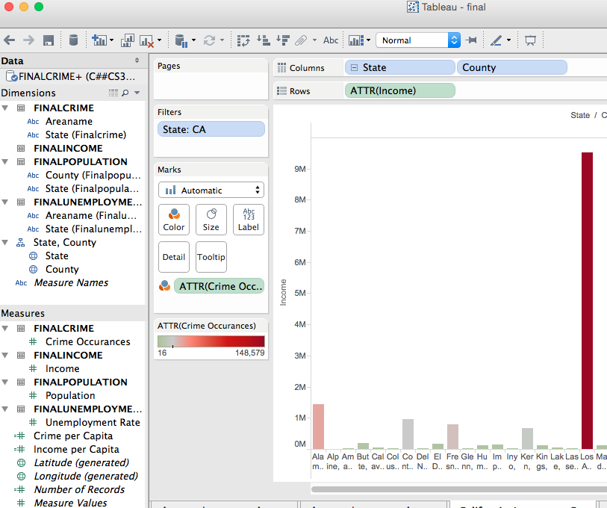
Sheet 3: California - Income vs. Crime

Slide 16
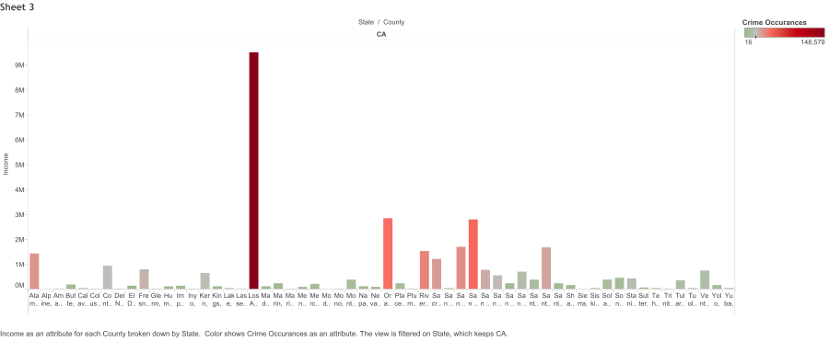
Sheet 3: California - Income vs. Crime

Slide 17
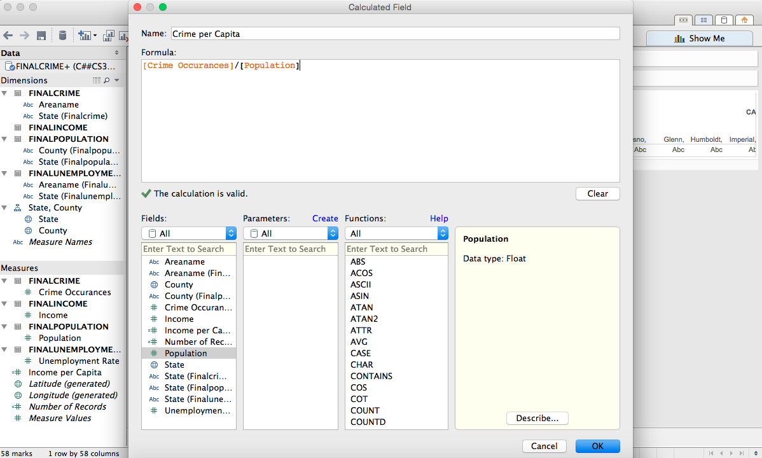
Sheet 4: California - Crime per Capita
Created a calculated field

Slide 18
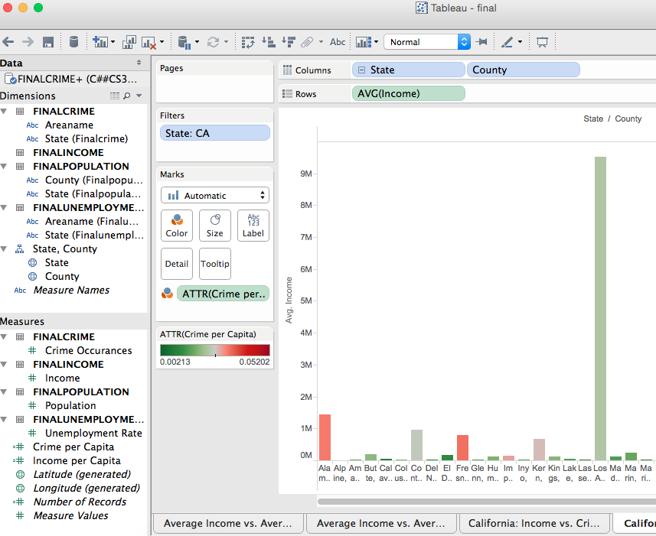
Sheet 4: California - Crime per Capita

Slide 19
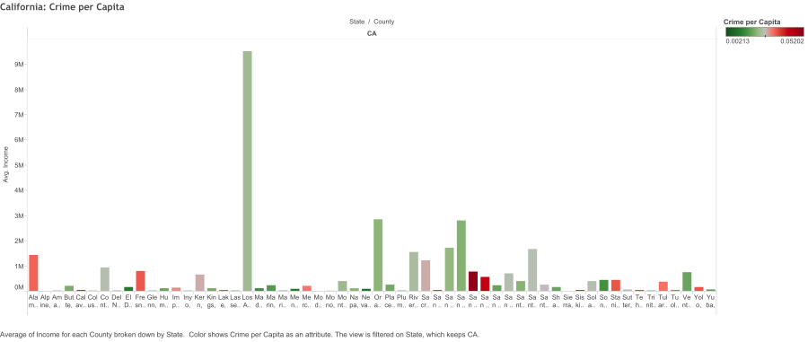
Sheet 4: California - Crime per Capita

Slide 20
What the Data Shows
More investigation needed, but there is a correlation between income levels and crime

Slide 21
Steps for the Future
Run this analysis for many states and demographic data (education, poverty, birth rate, etc)
Could use this kind of analysis for planning future legislation

Slide 22
Questions?

